Slide 1
Model Representation
Linear regression with one variable
Instructor: Wei Ding

Slide 2
Background
Parametric models for classification and regression
We make some assumptions about the nature of the data distribution (either p(y|x) for a supervised problem or p(x) for an unsupervised problem. )
These assumptions, known as inductive bias, are often embodied in the form of a parametric model, which is a statistical model with a fixed number of parameters.
Linear regression
Logistic regression

Slide 3
Housing Prices
(Portland, OR)
220K
Price
(in 1000s of dollars)
1250
Size (feet²)
Supervised Learning
Given the “right answer” for each example in the data.
Regression Problem
Predict real-valued output

Slide 4
Training set of
housing prices
(Portland, OR)
Size in feet² (x) | Price ($) in 1000's (y)
2104 | 460
1416 | 232
1534 | 315
852 | 178
… | …
x⁽¹⁾
y⁽¹⁾
m=47
examples
Notation:
m = Number of training examples
x’s = “input” variable / features
y’s = “output” variable / “target” variable
x⁽³⁾= ?
y⁽³⁾=?
(x,y) – one training example
(x^{(i)} , y^{(i)}) – i^{th} training example

Slide 5


Training Set
How do we represent h ?
$h_{θ}$(x)= $θ0$+ $θ1$x
Shorthand: h(x)
Learning Algorithm
x
y
x
$h$(x)= $θ0$+ $θ1$x
x
x
x
x
x
Size of house
h
Estimated price
x
x
hypothesis
estimated
value of y
Linear regression with one variable.
Univariate linear regression.
h maps from x’s to y’s

Slide 6
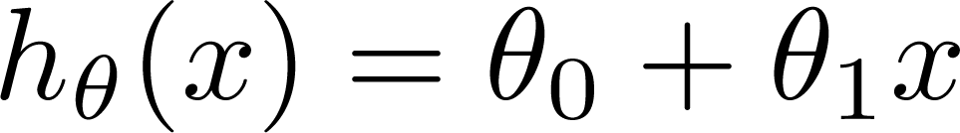

Training Set
Size in feet² (x) | Price ($) in 1000's (y)
2104 | 460
1416 | 232
1534 | 315
852 | 178
… | …
Hypothesis:
‘s: Parameters
How to choose ‘s ?

Slide 7
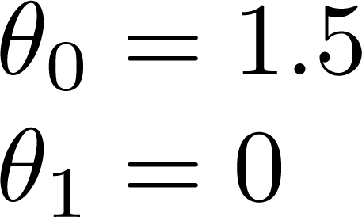
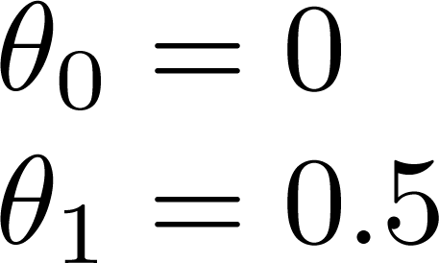
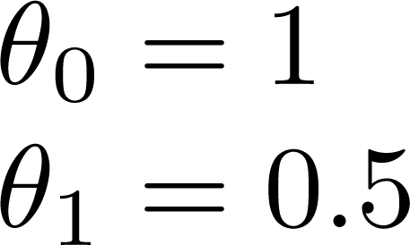



$h$(x)= $1$+ $0$.5x
$h$(x)= $0$+ $0.5$x
$h$(x)= $1.5$+ $0$x

Slide 8
Cost Function
Linear regression with one variable

Slide 9
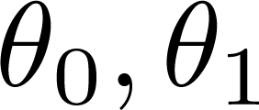


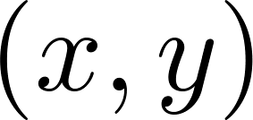


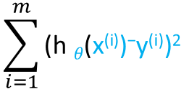
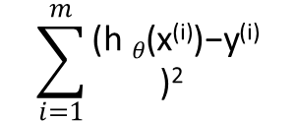

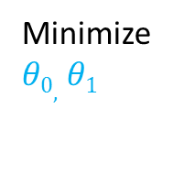



m is the number of training examples
Minimize
$θ0,$ $θ1$
$$\sum_{i=1}^{m}{\text{(}\text{h} θ\text{(}\text{x}\text{(}\text{i}\text{))−}\text{y}\text{(}\text{i}\text{))2 }}$$
$$\frac{1}{2m}$$
y
$θ0,$ $θ1$
$h_{θ}$($\text{x}\text{(}\text{i}\text{)}$)= $θ0$+ $θ1\text{x}\text{(}\text{i}\text{)}$
x
$$\sum_{i=1}^{m}{\begin{aligned}\text{(}\text{h} θ\text{(}\text{x}\text{(}\text{i}\text{))−}\text{y}\text{(}\text{i}\text{)} \\ \text{)}\text{2} \end{aligned}}$$
$$\frac{1}{2m}$$
(x^{(i)} , y^{(i)})
$J(θ0,$ $θ1)=$
Idea: Choose so that is close to for our training examples
Minimize $J(θ0,$ $θ1)$
$θ0,$ $θ1$
Cost Function
Squared Error Cost Function

Slide 10
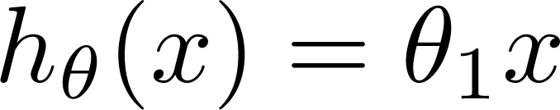

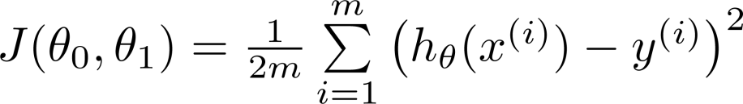
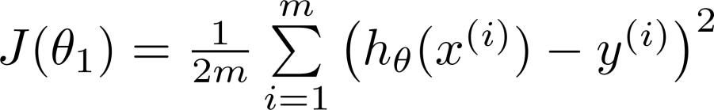
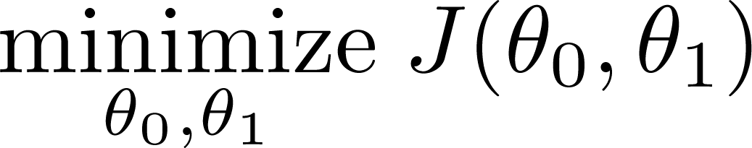
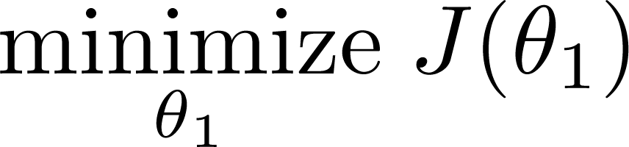


Simplified
Hypothesis:
$θ0$=0
Parameters:
h(x)
h(x)
Cost Function:
$h_{θ}$($\text{x}\text{(}\text{i}\text{)}$)= $θ1\text{x}\text{(}\text{i}\text{)}$
Goal:

Slide 11








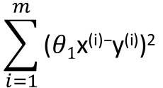
(for fixed , this is a function of x)
(function of the parameter )
y
X
x
J($θ1$) when $θ1$=1
$$\sum_{i=1}^{m}{\text{(}θ1\text{x}\text{(}\text{i}\text{)−}\text{y}\text{(}\text{i}\text{))2 }}$$
J(1)=0
$$\frac{1}{2m}$$
$$\frac{1}{2m}$$
=
=
(0²+0²+0²)=0²

Slide 12








X
X
(for fixed , this is a function of x)
(function of the parameter )
X
X
y
$$\text{y}\text{(}\text{i}\text{)}$$
X
X
$$\text{h} θ\text{(}\text{x}\text{(}\text{i}\text{))}$$
X
x
$θ$ =-0.5
$θ$ =0
J(0.5)=
$\frac{1}{2m}$ [(0.5-1)²+(1-2)²+(1.5-3)²]
h(x)
=
$\frac{1}{2∗3}$ (3.5)=0.58

Slide 13
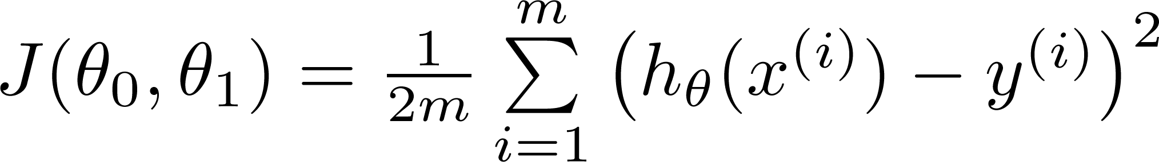
Hypothesis:
Parameters:
Cost Function:
Goal:

Slide 14
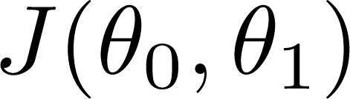


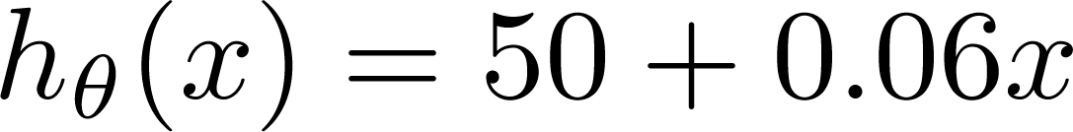
(for fixed , this is a function of x)
(function of the parameters )
We discussed how it looks like with one parameter θ₁. For two parameters θ₀, θ₁, what does the cost function look like?
Price ($)
in 1000’s
Size in feet² (x)

Slide 15
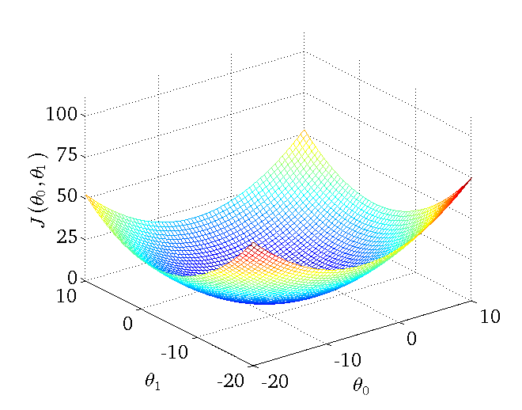
We will use contour plots/contour figures to show the 3D surface

Slide 16
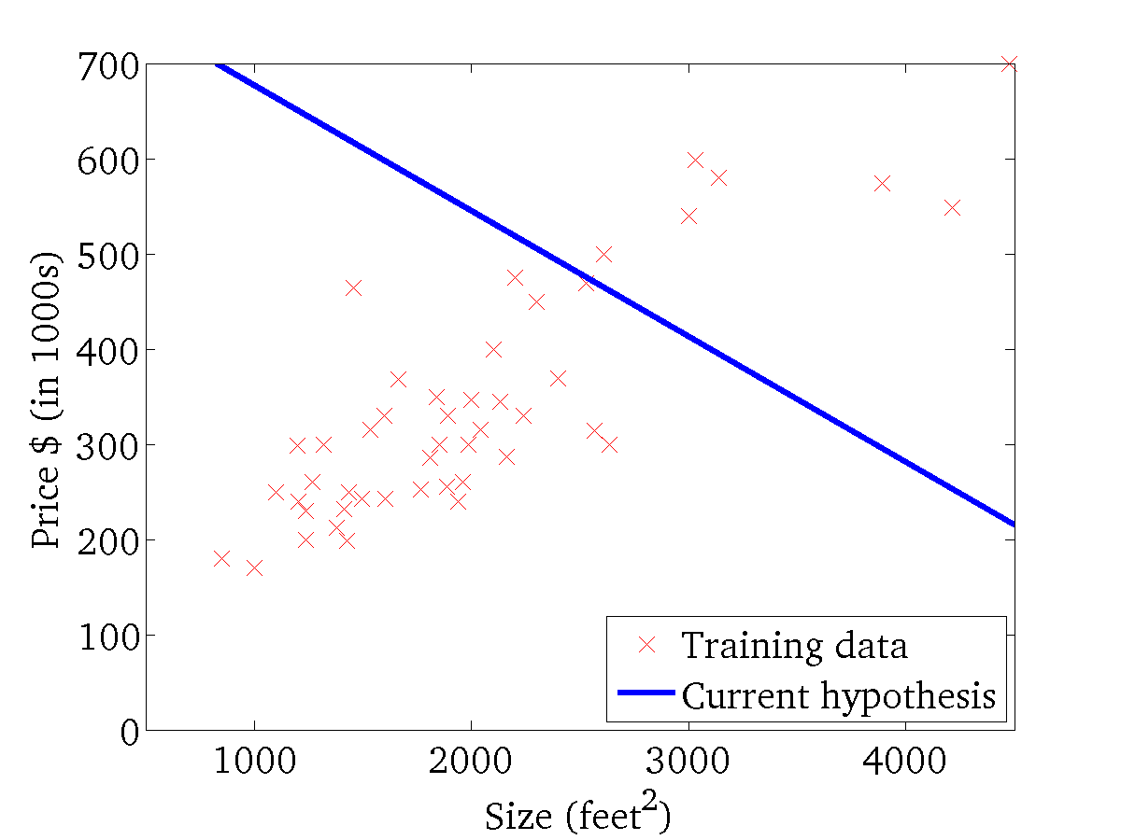
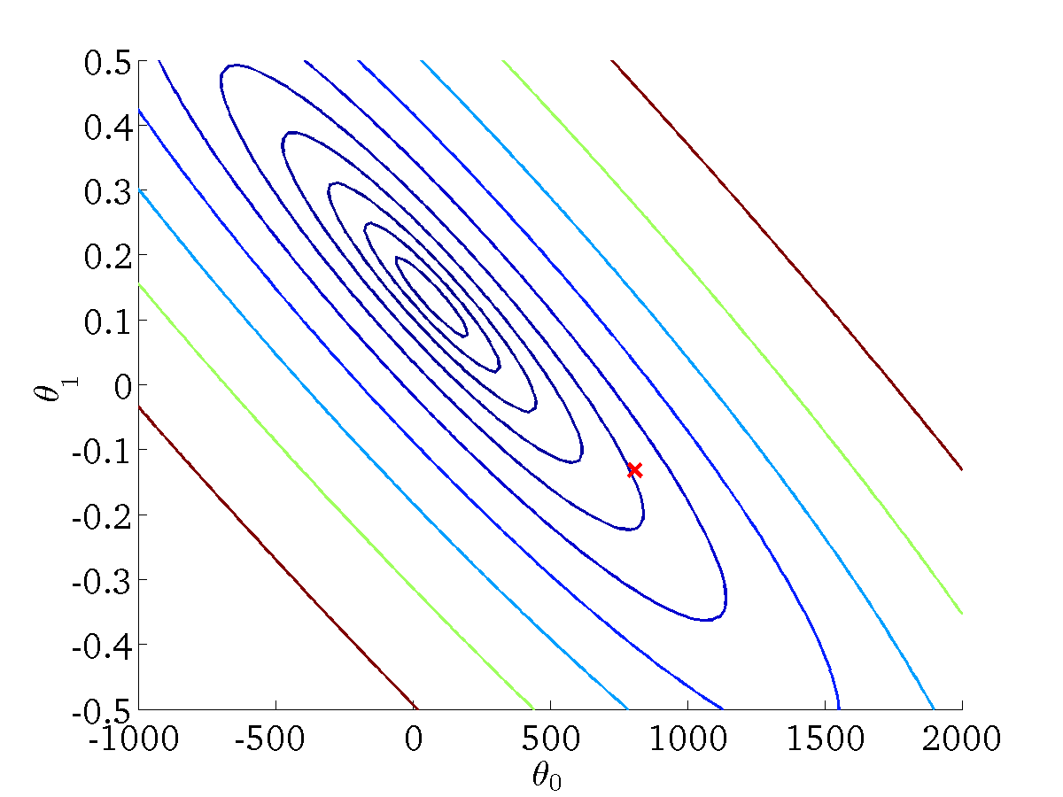
(for fixed , this is a function of x)
(function of the parameters )
x
3 X points have the same value on
x
x
x
θ₀=800, θ₁=-0.15
Where is the minimum value of

Slide 17
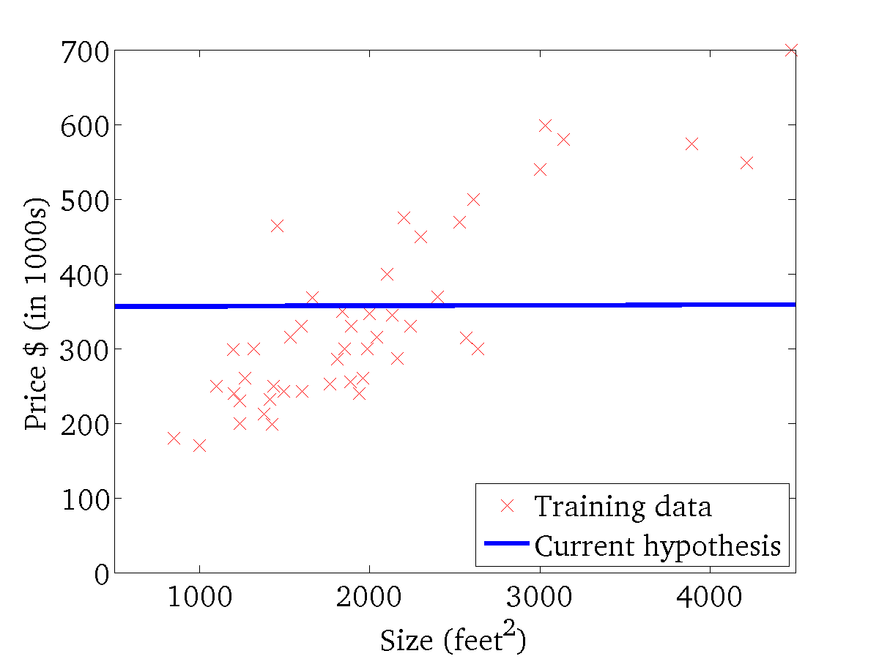
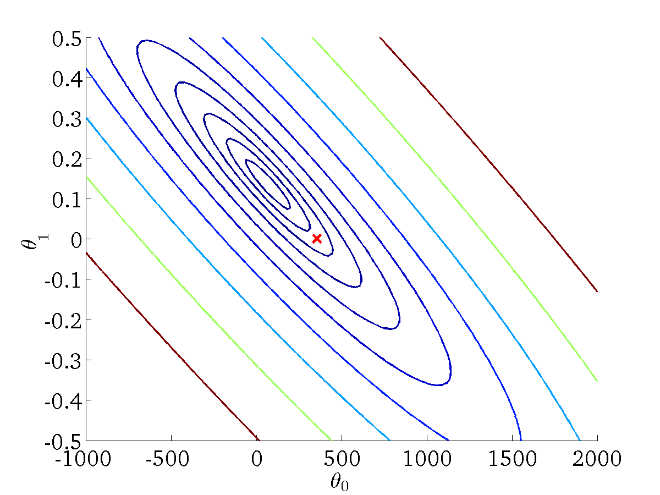
(for fixed , this is a function of x)
(function of the parameters )
h(x)=360+0X
θ₀,=360, θ₁=0

Slide 18
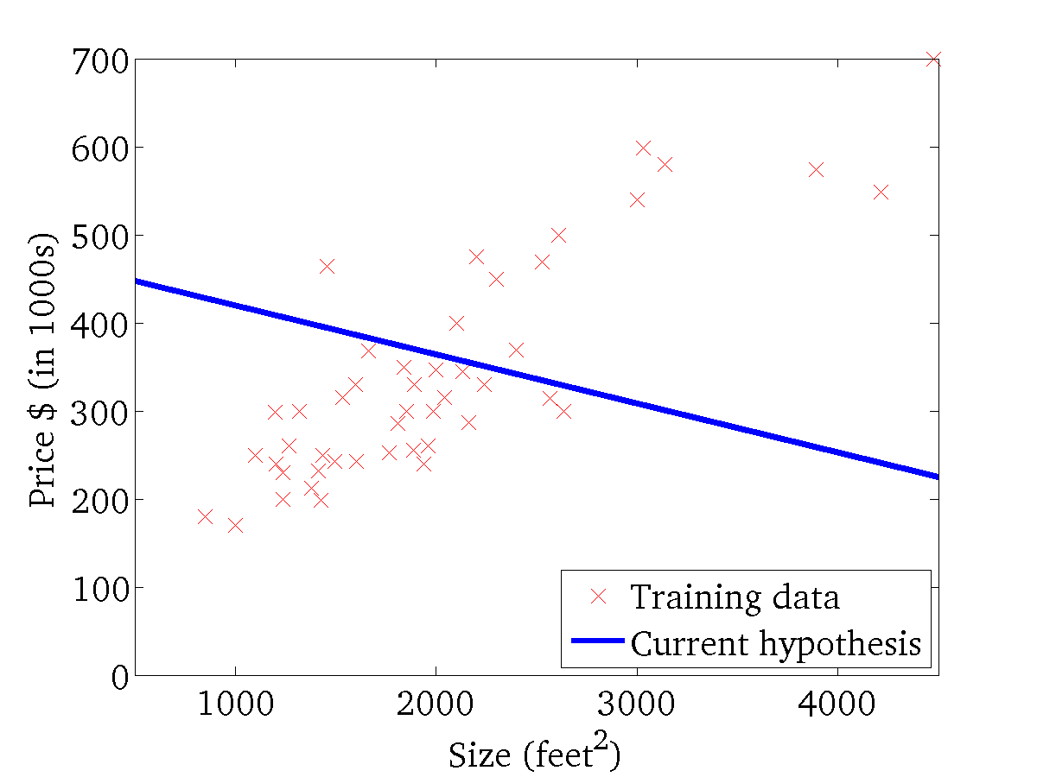

(for fixed , this is a function of x)
(function of the parameters )

Slide 19
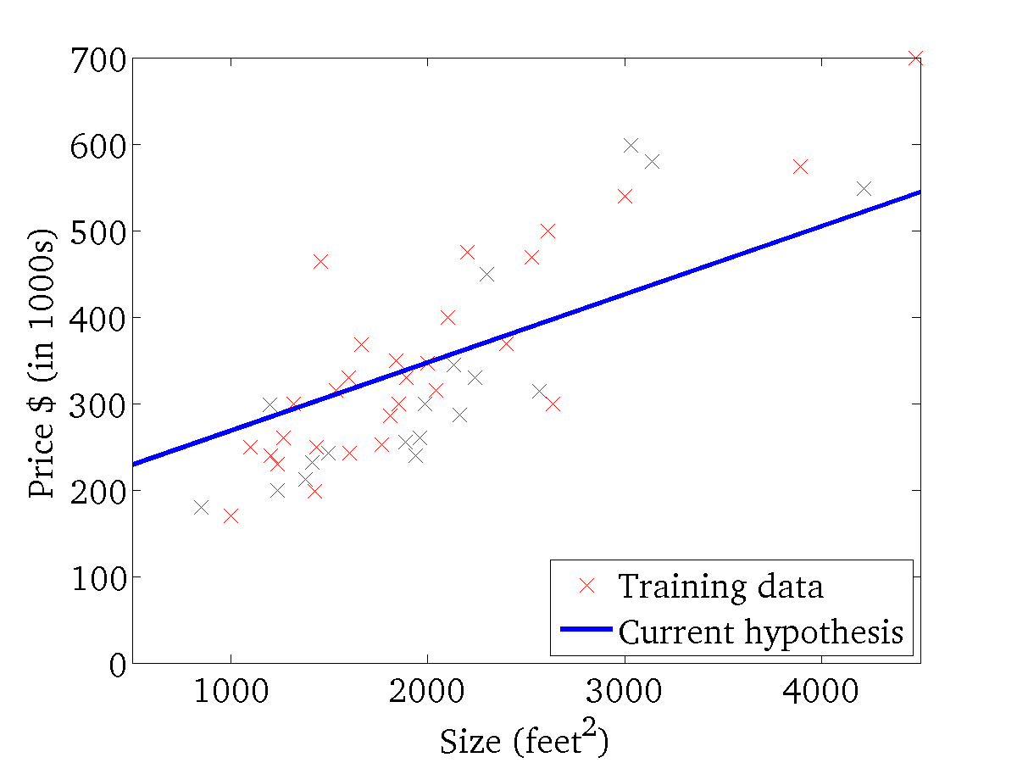
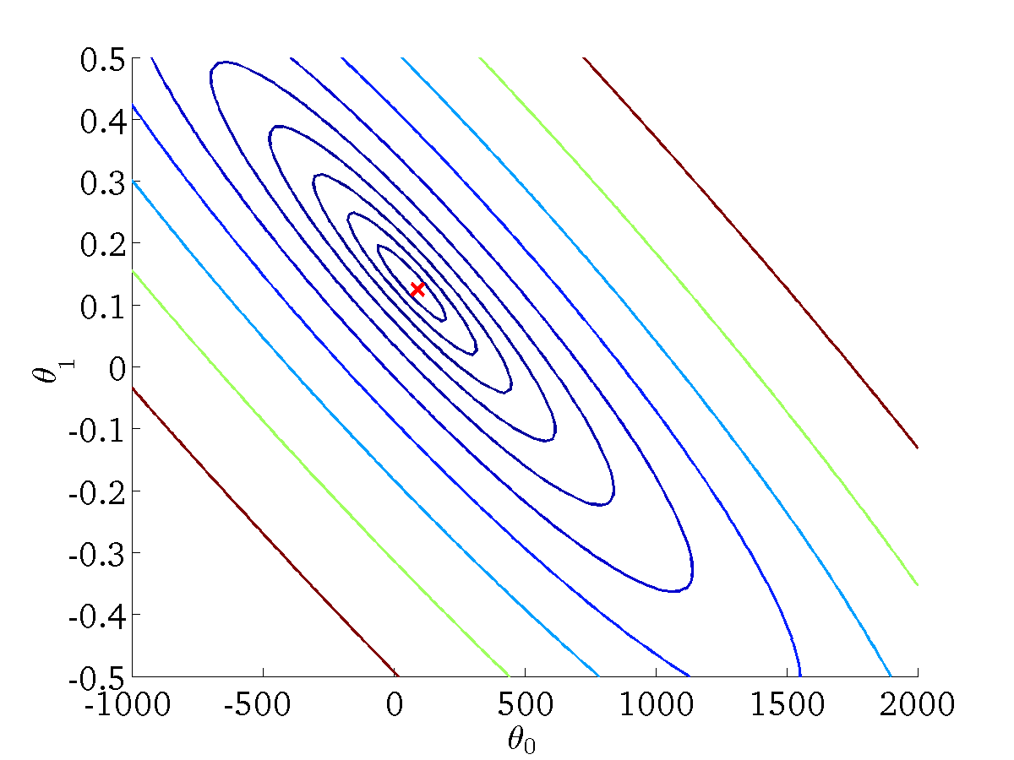
(for fixed , this is a function of x)
(function of the parameters )
h(x)

Slide 20
Gradient Descent
Linear regression with one variable

Slide 21
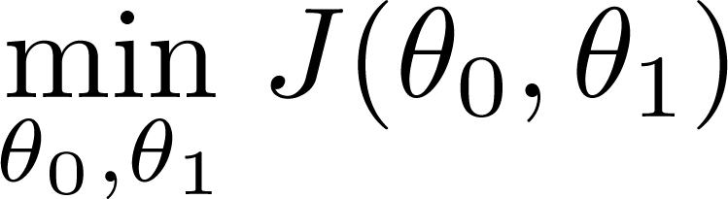
Have some function
Want
Outline:
Start with some
Keep changing to reduce until we hopefully end up at a minimum
Notes:
Discuss about more than two paramters

Slide 22
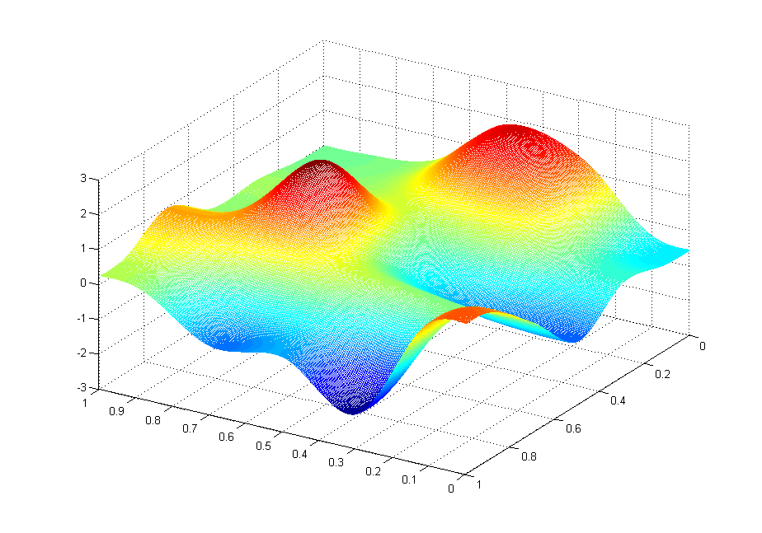
J(θ₀,θ₁)
θ₁
θ₀

Slide 23
Let start from a different initial value of θ₀ and θ₁
J(θ₀,θ₁)
θ₁
θ₀
We start from here in the previous slide
The searches end at 2 different local minimums

Slide 24
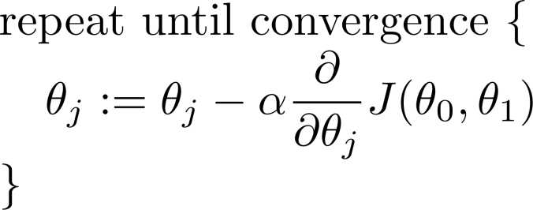
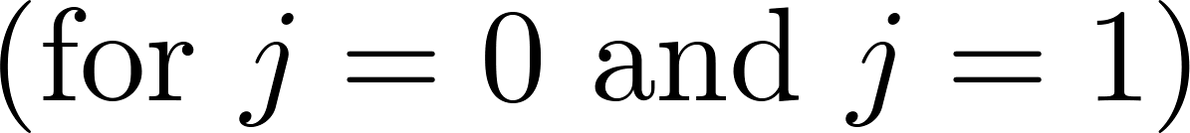
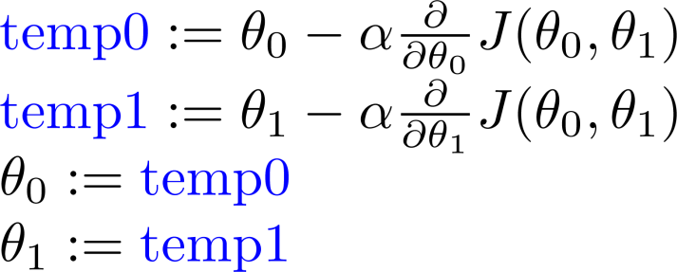
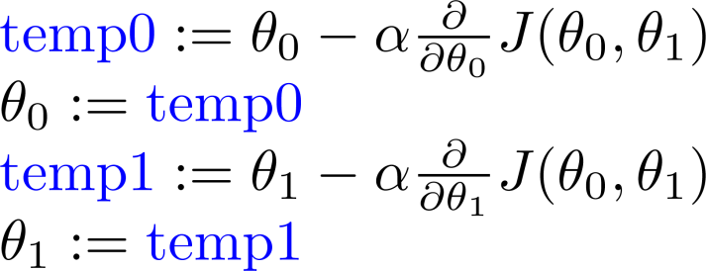
Gradient descent algorithm
α is the learning rate
Correct: Simultaneous update
Incorrect:

Slide 25
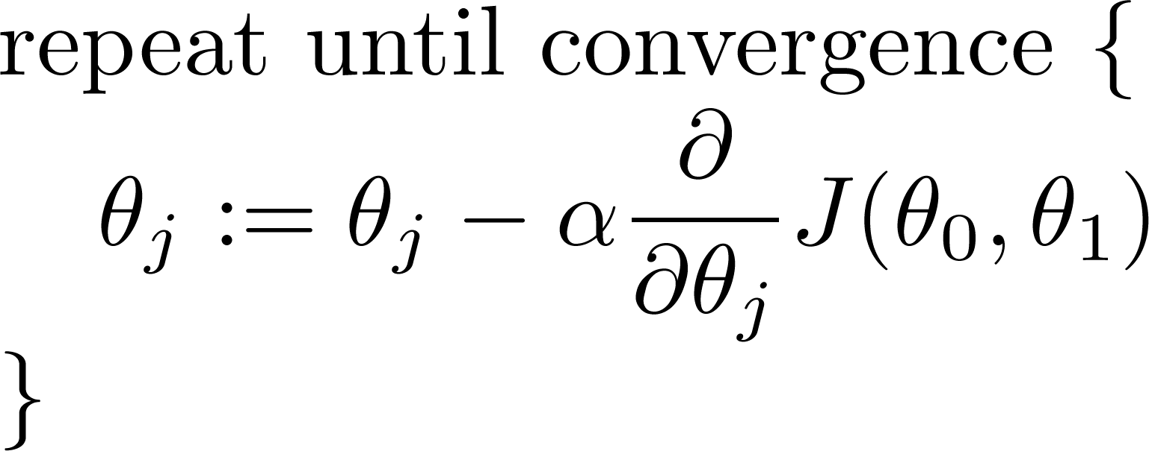
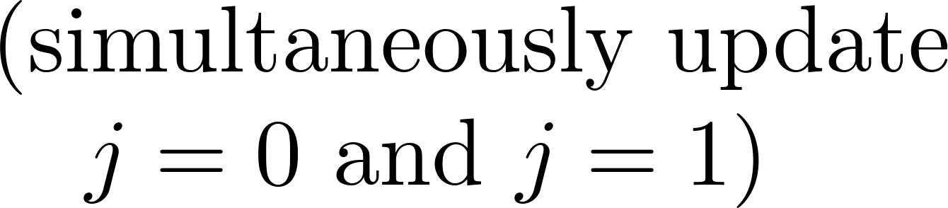
Gradient descent algorithm
α is the learning rate
derivative

Slide 26
Illustrate the idea of gradient descent on white board

Slide 27
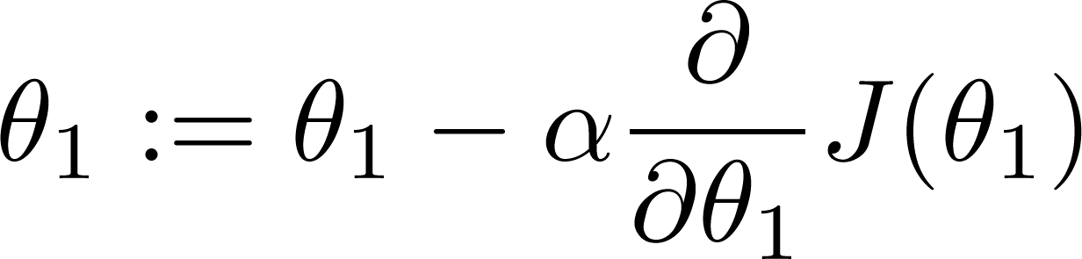
If α is too small, gradient descent can be slow.
If α is too large, gradient descent can overshoot the minimum. It may fail to converge, or even diverge.

Slide 28

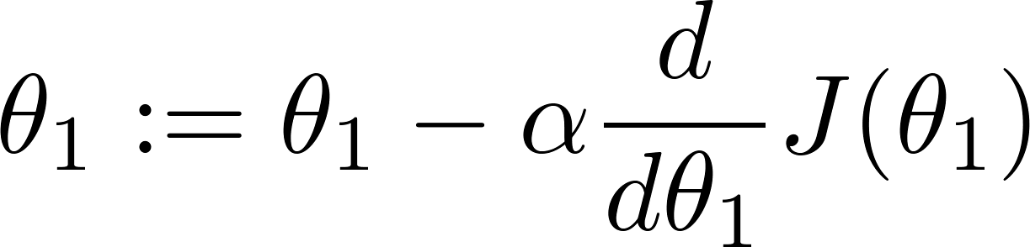
at local optima; slope = 0
Current value of
0

Slide 29
Gradient descent can converge to a local minimum, even with the learning rate α fixed.
As we approach a local minimum, gradient descent will automatically take smaller steps. So, no need to decrease α over time in general.
Slope becomes smaller

Slide 30
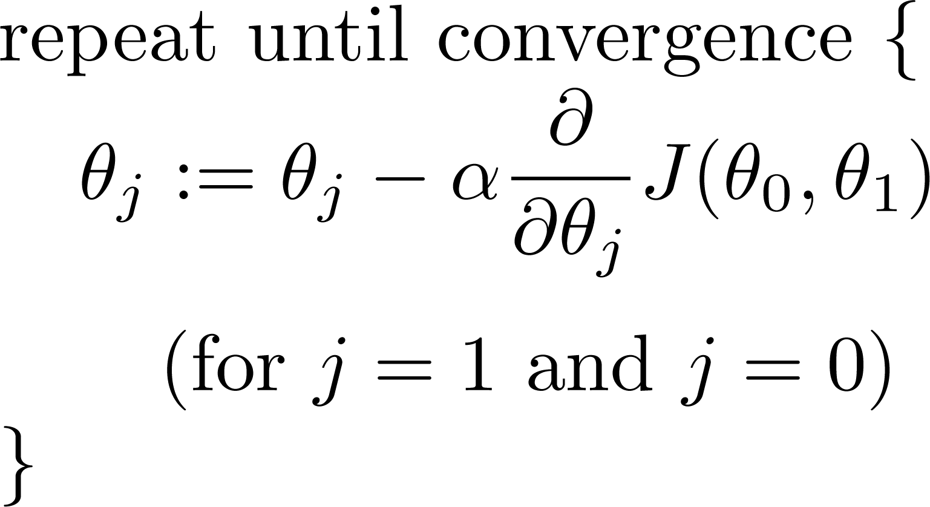
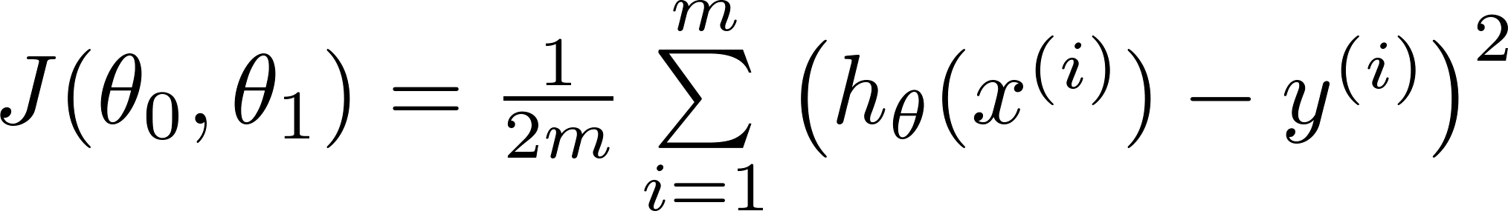
Gradient descent algorithm
Linear Regression Model

Slide 31
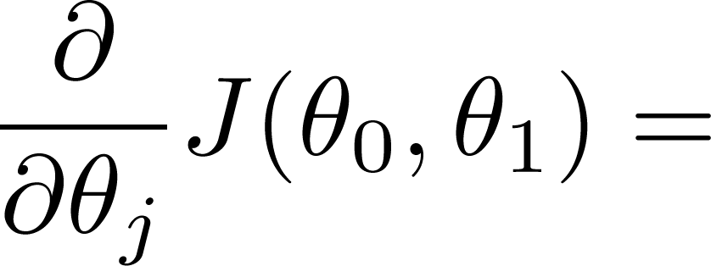
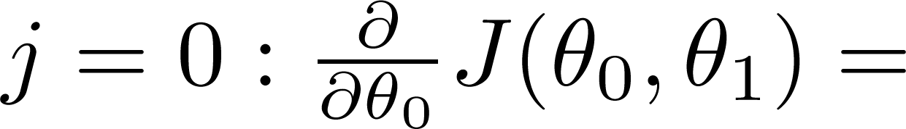
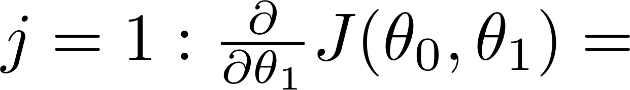

Slide 32
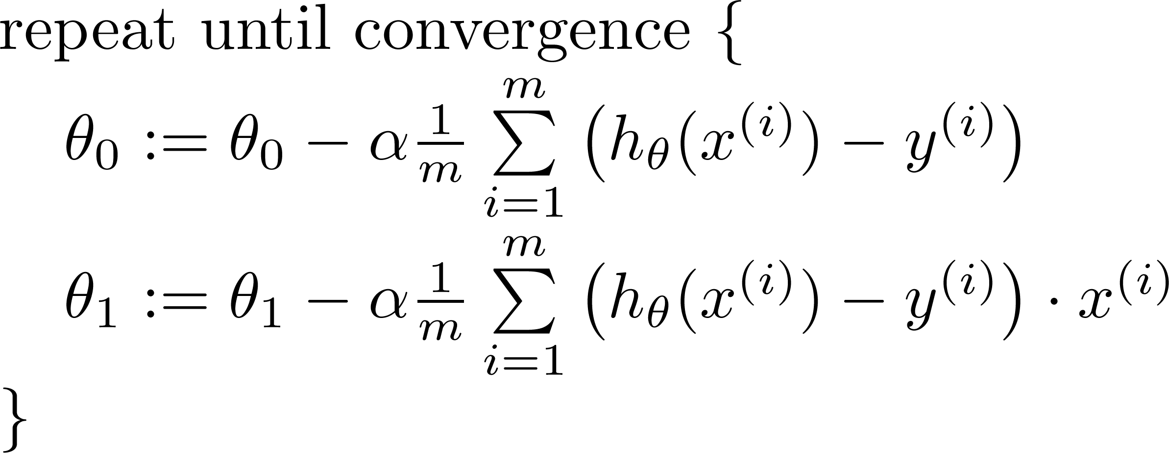

Gradient descent algorithm
update
and
simultaneously

Slide 33
One local optimal
J(θ₀,θ₁)
θ₁
θ₀

Slide 34
Another local optimal
J(θ₀,θ₁)
θ₁
θ₀

Slide 35
The Cost Function for linear regression: Convex Function (bowl shaped)
No local optimal

Slide 36
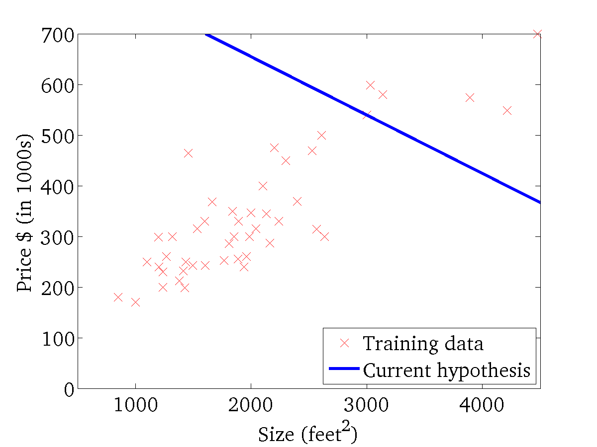
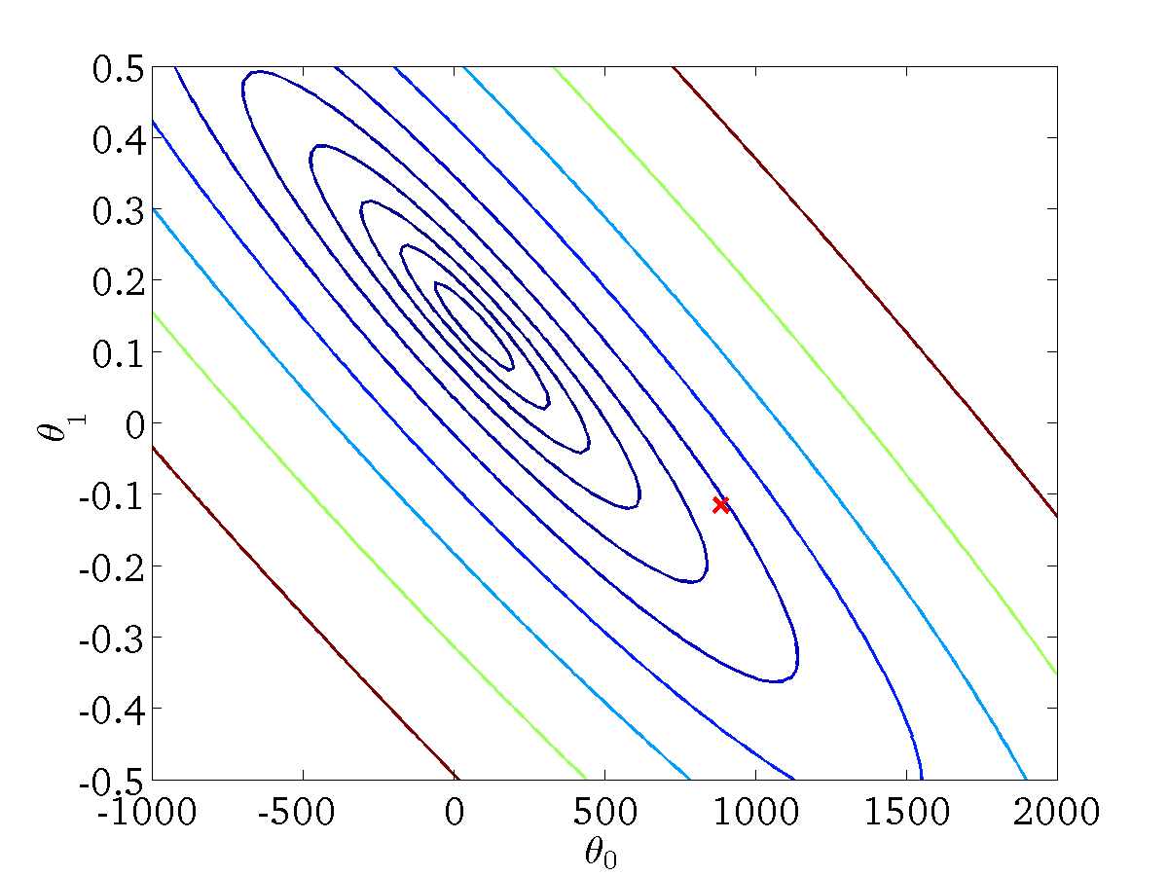
(for fixed , this is a function of x)
(function of the parameters )
H(x) = -900-0.1x

Slide 37

(for fixed , this is a function of x)
(function of the parameters )

Slide 38
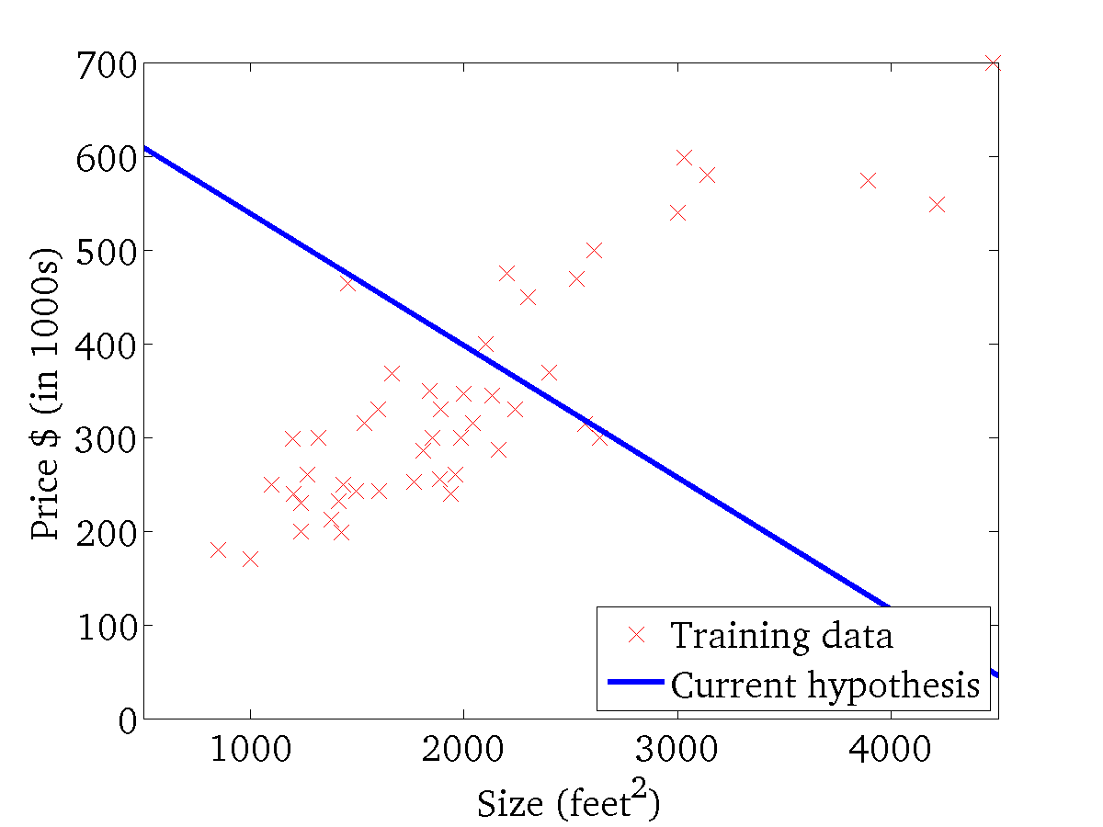
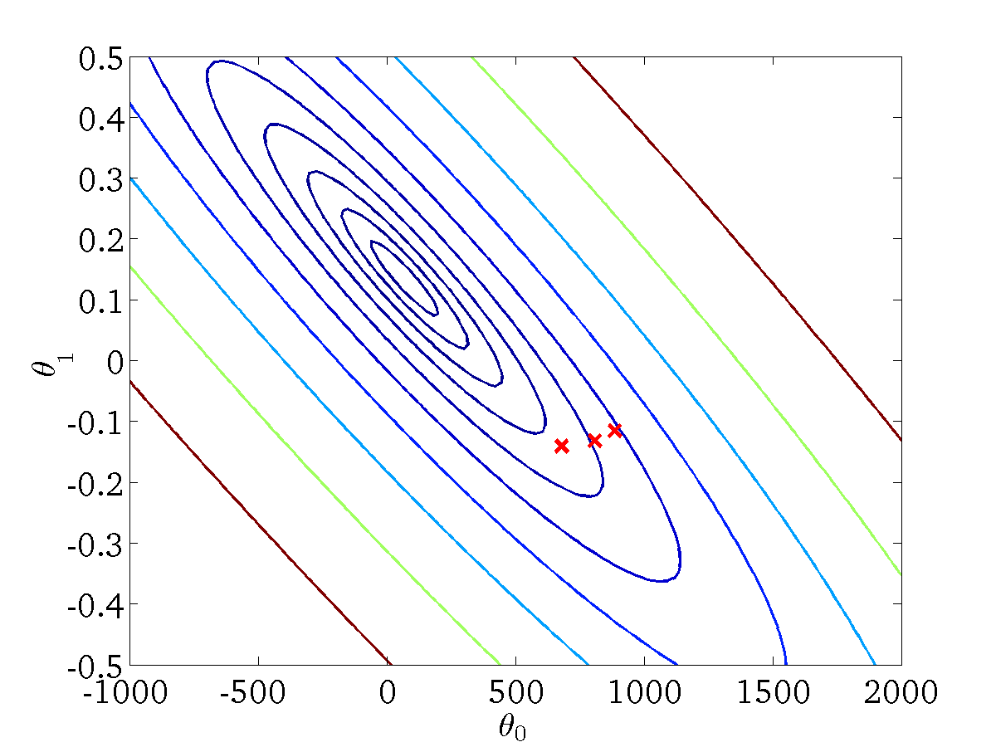
(for fixed , this is a function of x)
(function of the parameters )

Slide 39
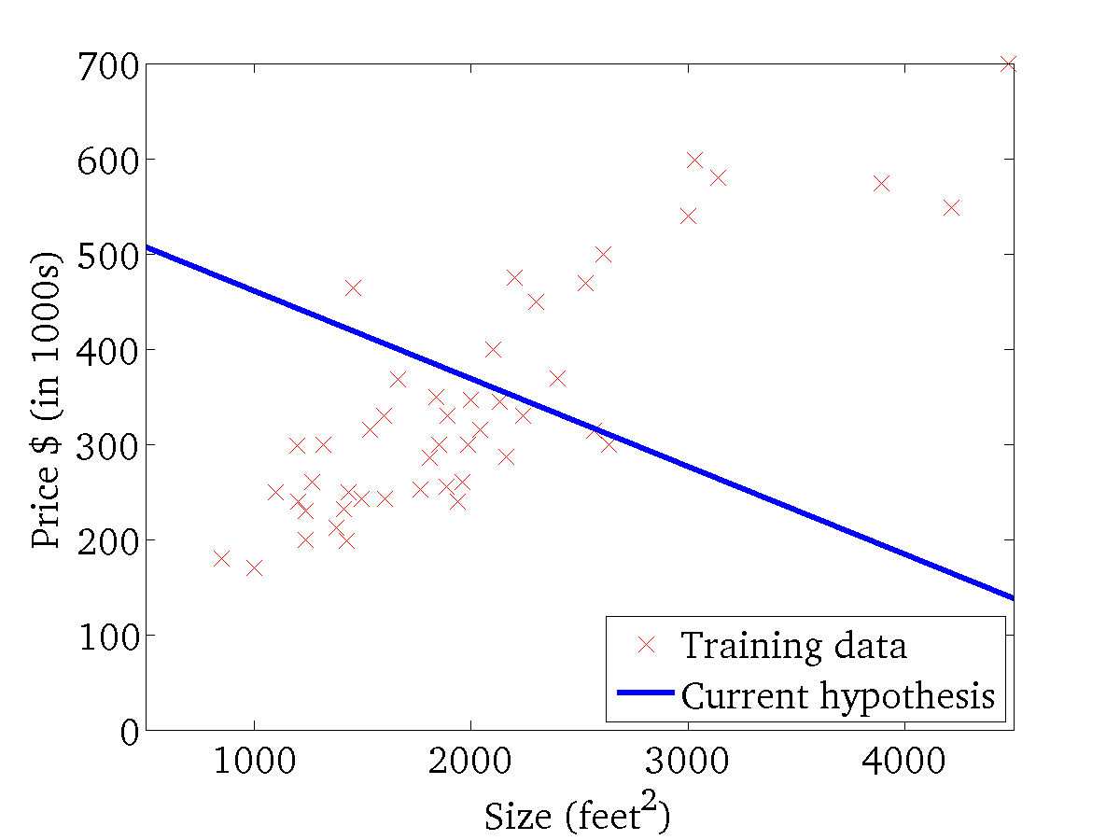

(for fixed , this is a function of x)
(function of the parameters )

Slide 40
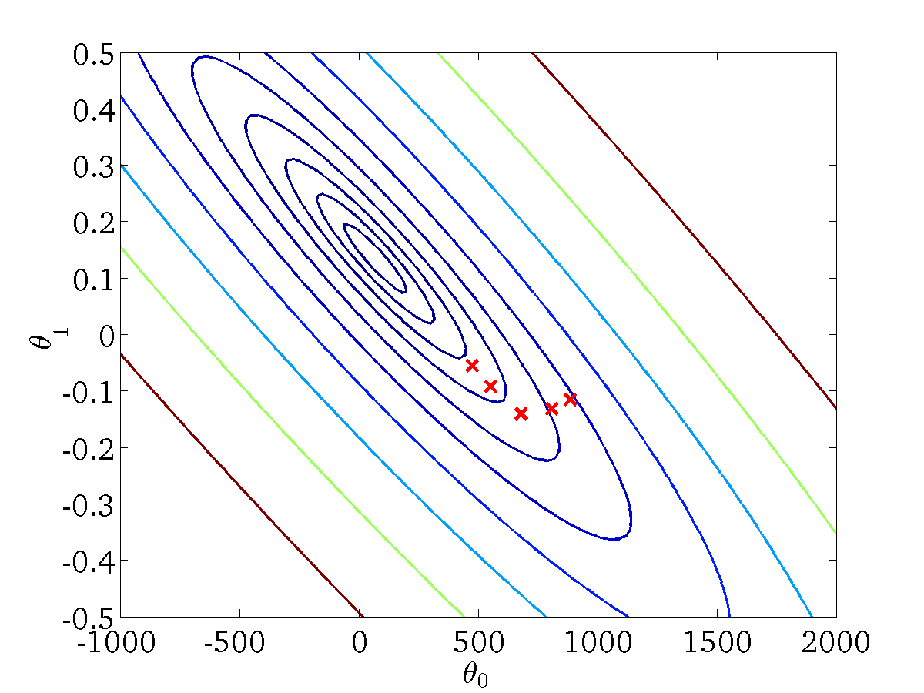
(for fixed , this is a function of x)
(function of the parameters )

Slide 41

(for fixed , this is a function of x)
(function of the parameters )

Slide 42
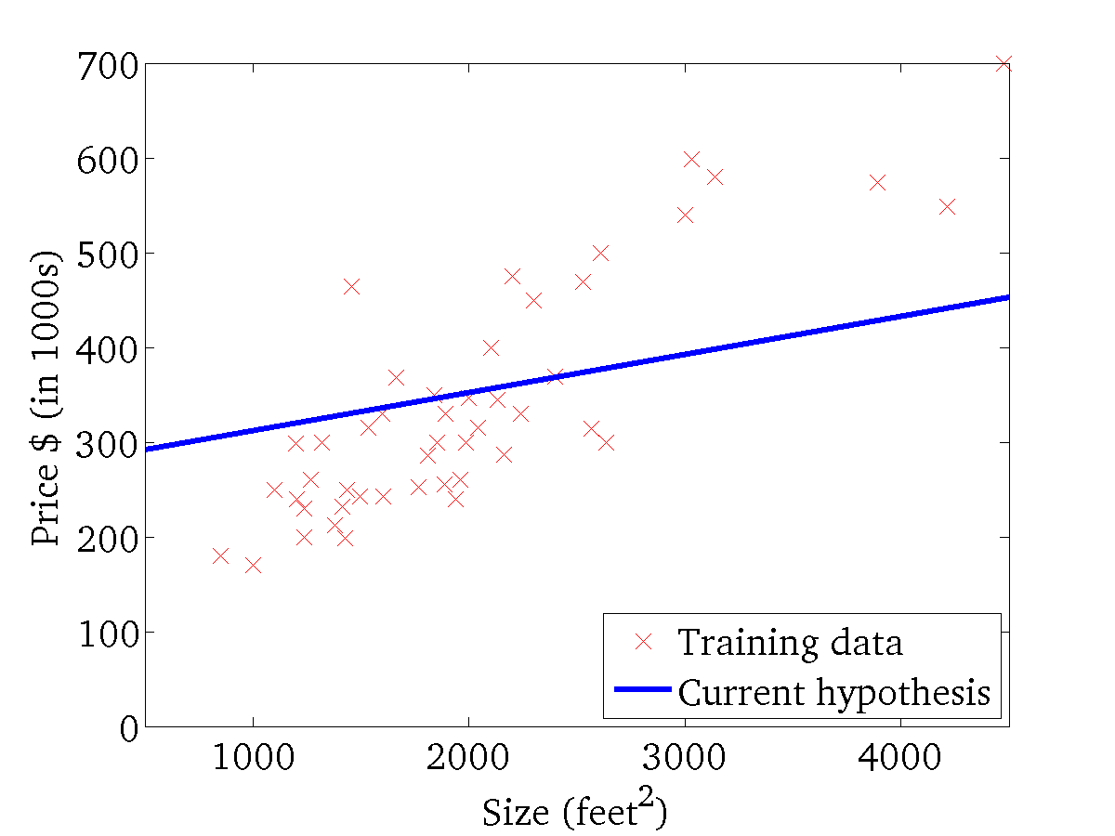

(for fixed , this is a function of x)
(function of the parameters )

Slide 43

(for fixed , this is a function of x)
(function of the parameters )

Slide 44


(for fixed , this is a function of x)
(function of the parameters )
1250

Slide 45
“Batch” Gradient Descent
“Batch”: Each step of gradient descent uses all the training examples.

